Slide 1
Inferential Statistics
Aniket Chhabra

Slide 2
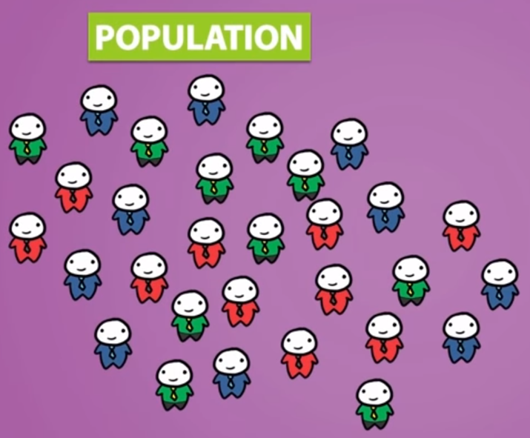

Sampling and Population
Population - True population is entire collection of data which we want to analyze, describe and draw conclusions about
Sample – The part of true population that we actually examine in order to gather information and draw valid conclusion about the larger group
Note – We should always be unbiased towards picking up a sample since it may draw incorrect conclusions

Slide 3





Sampling and Population Contd…
Types of Sampling -
Simple Random Sampling - Simple random sampling is the simplest form of sampling. Each member of the population has an equal and known chance of being selected
Stratified Random Sampling - Simple random sampling is the simplest form of sampling. Each member of the population has an equal and known chance of being selected
Other types of sampling – Biased Sampling, Systematic Sampling, multistage sampling etc

Slide 4
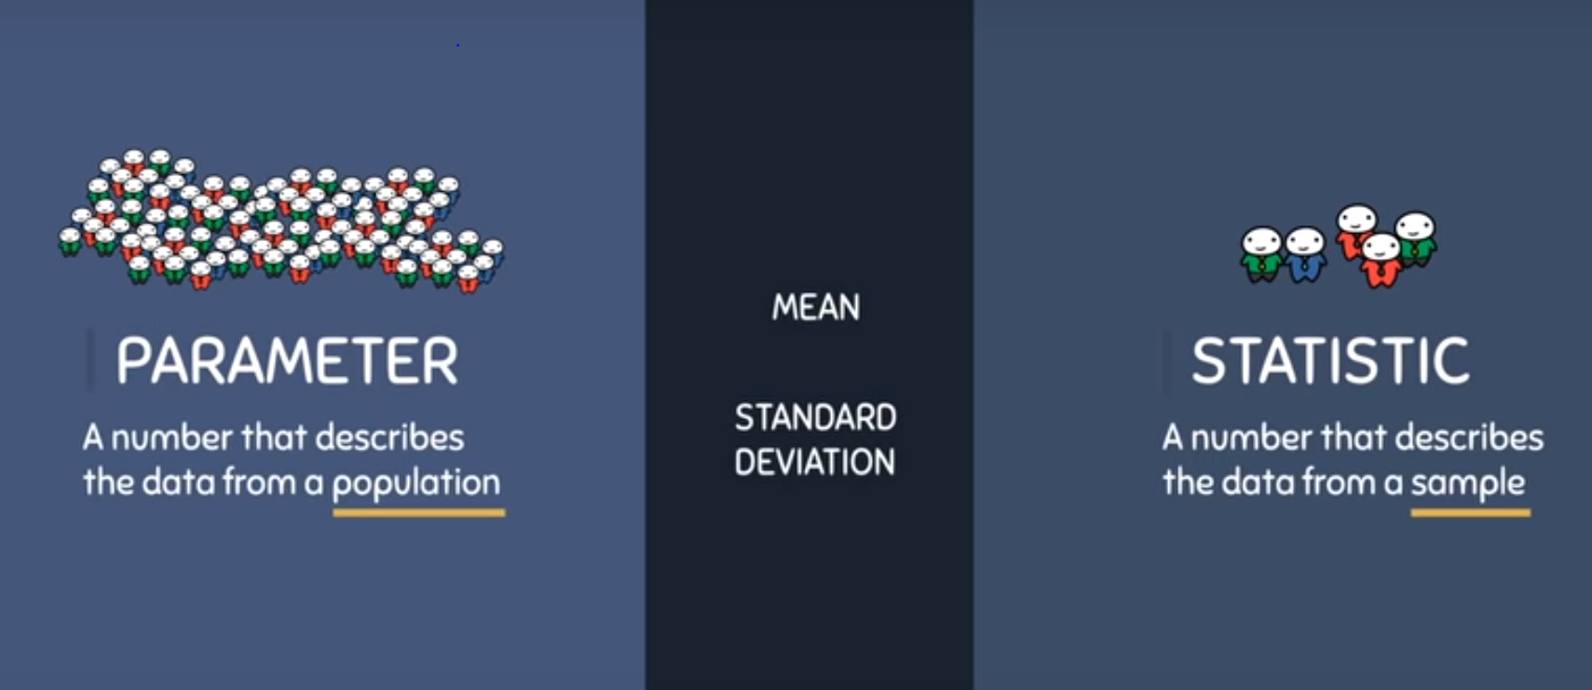
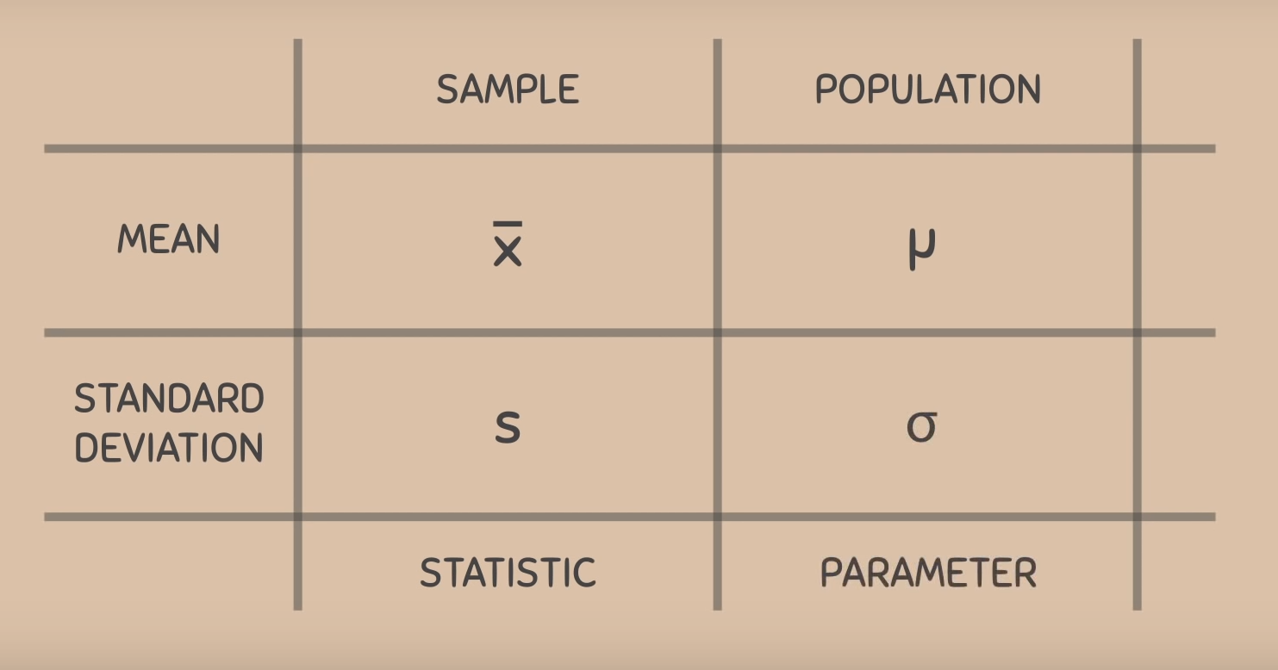
Parameter v/s Statistic
Example – A properly chosen sample of 1600 people across the country was asked if they regularly watch a certain television program, 24% said yes
Parameter – The true proportion of all people in the country who watch the program
Statistic - 24%, obtained from a sample of 1600 people

Slide 5
Probability Theory
The chance that an event will occur
Total number of favorable outcomes
Total number of possible outcomes
Probability Formula
Flipping a coin –
Total number of possible outcomes – 2 (Head or Tail)
Total number of favorable outcomes – 1 (either a head or tail)
Probability Formula = 1/2
Rolling a die –
Total number of possible outcomes – 6
Total number of favorable outcomes – 1
(any number from 1 to 6)
Probability Formula = 1/6
Flipping two coins –
Total number of possible outcomes – 4 (HH, HT, TH, TT)
Total number of favorable outcomes – 1 (one out of above 4)
Probability Formula for both heads = 1/4

Slide 6

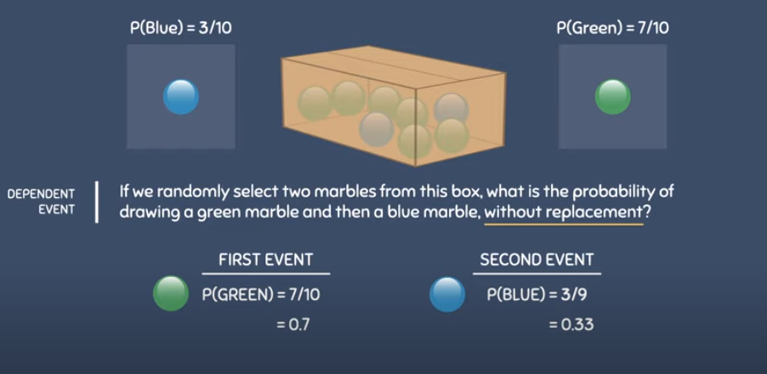
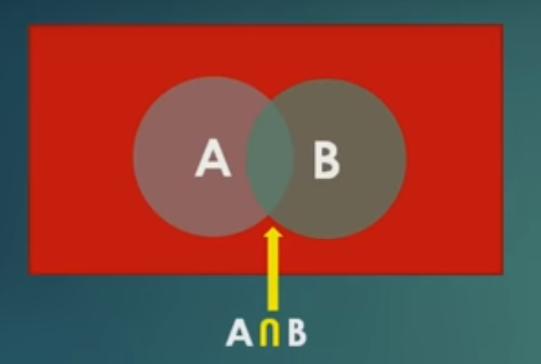
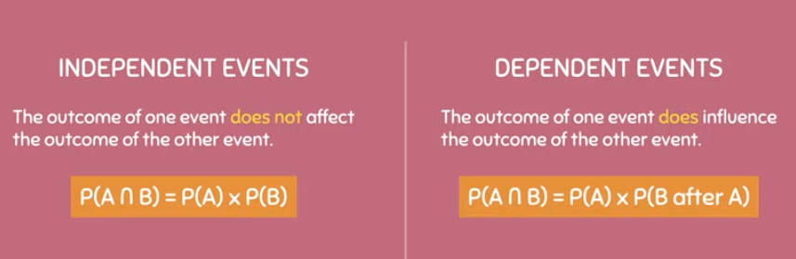
Independent and Dependent Events
Refer to the occurrence of one event not affecting the probability of another event
Rolling two dice
Flipping two coins
P(A B) = P(A) X P(B)
Dependent Events – Refer to the occurrence of one event affecting the probability of another event
A box containing 10 marbles – 7 green and 3 blue
Probability of select a green marble -
P(green) = 7/10
Probability of select a blue marble -
P(blue) = 3/10
^{P(Green and Blue Marble) =}
^{7/10 X 3/9}
Mutually Exclusive Events – the occurrence of one event blocks another event
Exhaustive Events – the outcome of all events completes the sample space

Slide 7
Probability Theory Contd.
The chance that an event will occur
Sample Space – Entire set of possible outcomes -
(Head or Tail)
Probability Rules –
The probability of an event occurring always has a value between 0 and 1, inclusive –
A prob of 0 means that event will not occur
A prob of 1 means that event will definitely occur
The probability of all outcomes of an event must always add up to 1
Examples of all outcomes of flipping a coin
Examples of all outcomes of flipping two coin
The complement Rule – Since the prob of all outcomes of an event always add up to 1, the prob that an event does not occur, is equal to 1 minus that event will occur
P(A^{C}) = 1 – P(A)
Q – If we flip two coins, what is the prob of not getting two tails?
Notes:
Probability of two events happening together – First event X second event – P(A) X P(B) (only if these are independent events)

Slide 8
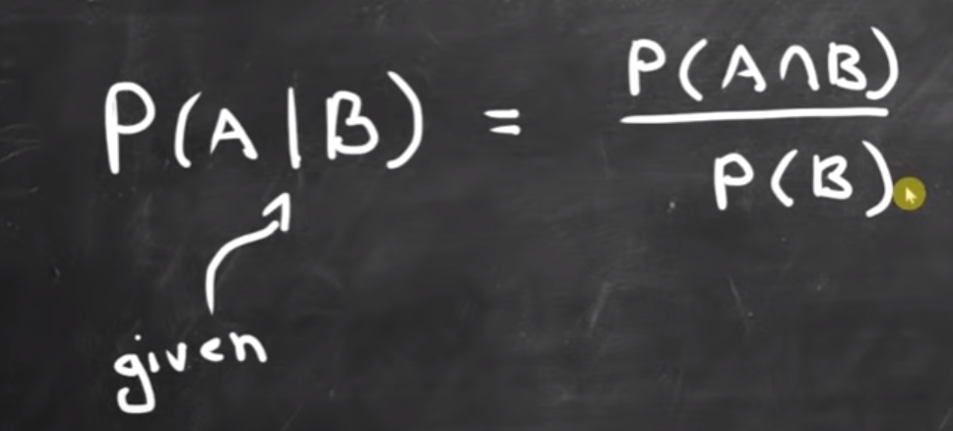
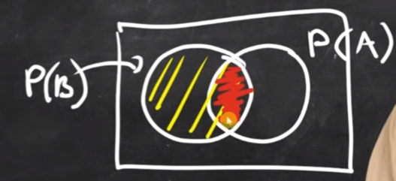
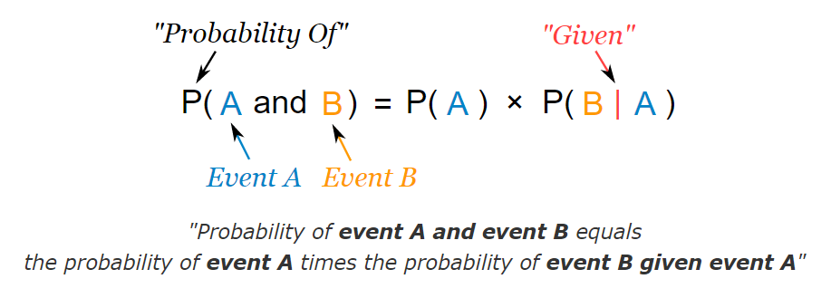
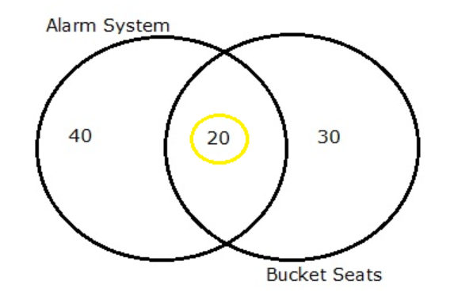
Probability Theory – Conditional Probability
The chance that an event will occur with a certain information given
Q - In a group of 100 sports car buyers, 40 bought alarm systems, 30 purchased bucket seats, and 20 purchased an alarm system and bucket seats. If a car buyer chosen at random bought an alarm system, what is the probability they also bought bucket seats?
Ans - N = 100
P(Alarm Systems) = 40/100
P(Bucket Seats) = 30/100
P(Alarm and Bucket) = 20/100
P(Bucket | alarm) = 20/100 / 40/100 = 0.5 or 50/100

Slide 9
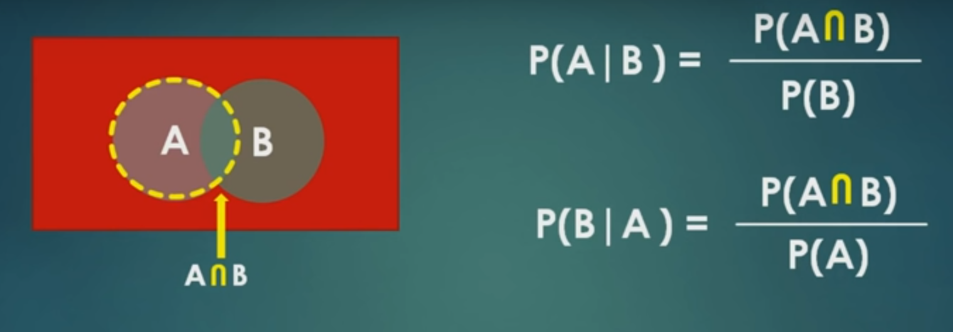
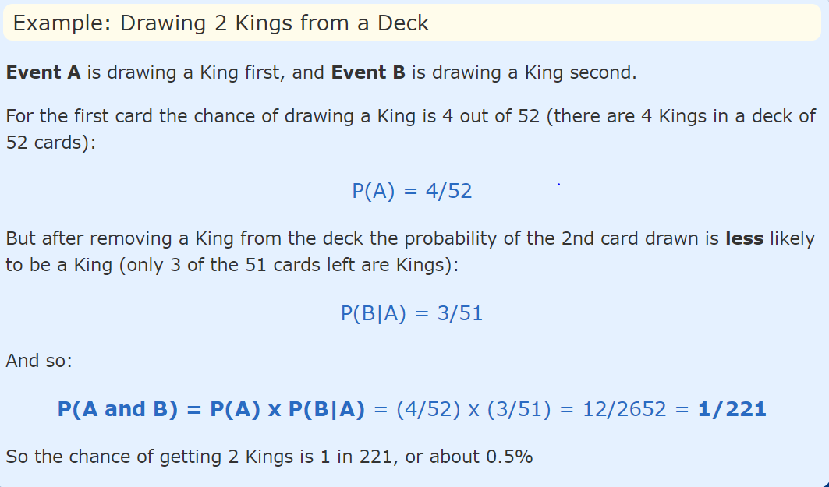
Probability Theory – Conditional Probability Contd…

Slide 10
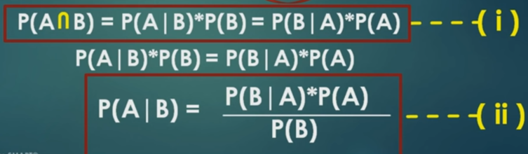
Probability Theory – Bayes Theorem
Q – In India, 5 out of 100 people are COVID-19 confirmed, Test are being conducted across the country and found that people who are confirmed the test gave 9 out of 10 times positive result and 1 out 10 times test gave positive result for people who are not-covid positive. Suppose 1 person is picked from the population and found that the test is +ve what are the chances that the person has COVID?
Ans - N = 100
P(COVID) = 5/100 = 5%
P(+|COVID) = 9/10 = 90%
P(-|COVID) = 1/10 = 10%
P(+|non - COVID) = 10/100 = 10%
P(-|non - COVID) = 90/100 = 90%
P(COVID | Test is Positive) = ??

Slide 11
Probability Distributions
Datasets are composed of two main types of data:
Numerical (eg. integers, floats)
Categorical (eg. names, laptops brands)
Numerical data can additionally be divided into other two categories: Discrete and Continuous -
Discrete data can take only certain values (eg. number of students in a school)
Continuous data can take any real or fractional value (eg. the concepts of height and weights)
Random Variable - is a variable whose possible values are numerical outcomes of a random phenomenon. There are two types of random variables –
Discrete
Continuous
Probability Distribution
The probability distribution of a random variable is the mathematical function describing the possible values of a random variable and their associated probabilities
From discrete random variables, it is possible to calculate Probability Mass Functions, while from continuous random variables can be derived Probability Density Functions

Slide 12
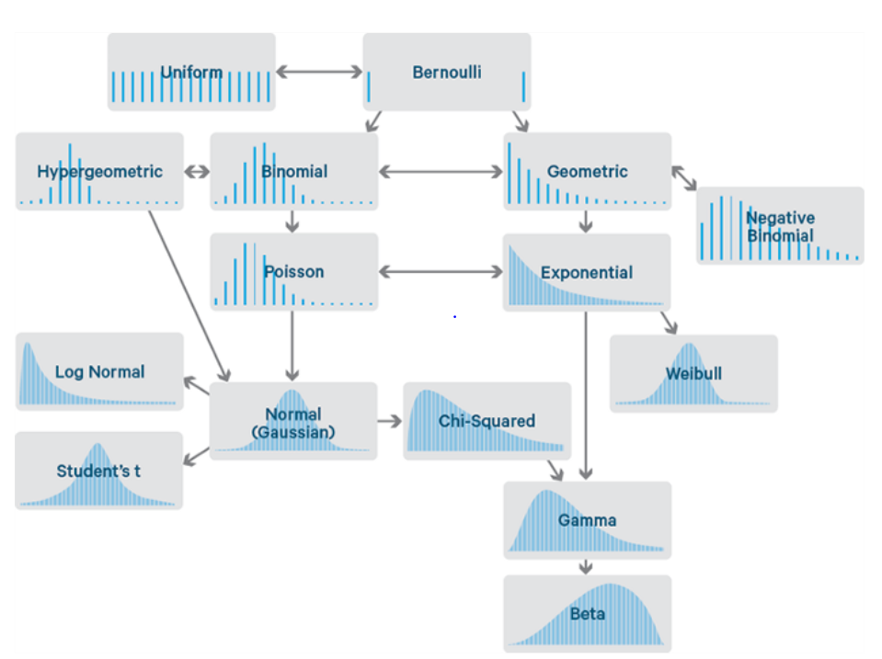
Probability Distributions Contd…

Slide 13
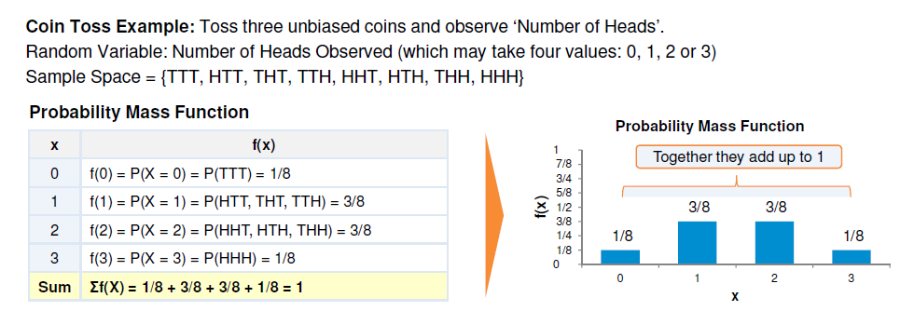
Discrete Distributions
Probability Mass Function (pmf) -
Bernoulli Distribution - This distribution has only two possible outcomes and a single trial
A simple example can be a single toss of a biased/unbiased coin. In this example, the probability that the outcome might be heads can be considered equal to p and (1 - p) for tails
Mean – p = p
Variance – p X (1-p) = p(1-p)
Uniform Distribution - The Uniform Distribution can be easily derived from the Bernoulli Distribution. In this case, a possibly unlimited number of outcomes are allowed and all the events hold the same probability to take place
Mean - A+B/2, Variance – (square(b-a+1) – 1) /12

Slide 14
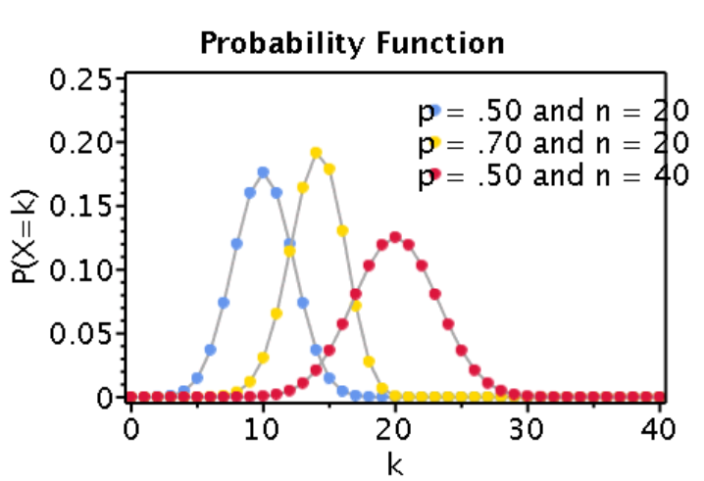
Discrete Distributions Contd…
Binomial Distribution - The Binomial Distribution can instead be thought as the sum of outcomes of an event following a Bernoulli distribution. The Binomial Distribution is therefore used in binary outcome events and the probability of success and failure is the same in all the successive trials. This distribution takes two parameters as inputs: the number of times an event takes place (n) and the probability assigned to one of the two classes (p)
Binomial Setting
Fixed number of trials
Only two possible outcomes of the trials - success or failure
Trials are independent and random
Prob of success of failure does not change during n trials
Note – The outcome of one trial does not influence another trial
A simple example of a Binomial Distribution in action can be the toss of a
biased/unbiased coin repeated a certain amount of times
Q – Flipping a coin 3 times, what is the probability of exactly getting 1 head and is this a binomial experiment??
N = 3, X = 1
P =0.5 (success)
1-p = 0.5 (failure)
Parameters of Binomial Distribution -
Mean of Binomial Distribution – n X p = np
Variance – n X p X (1-p) = np(1-p)

Slide 15
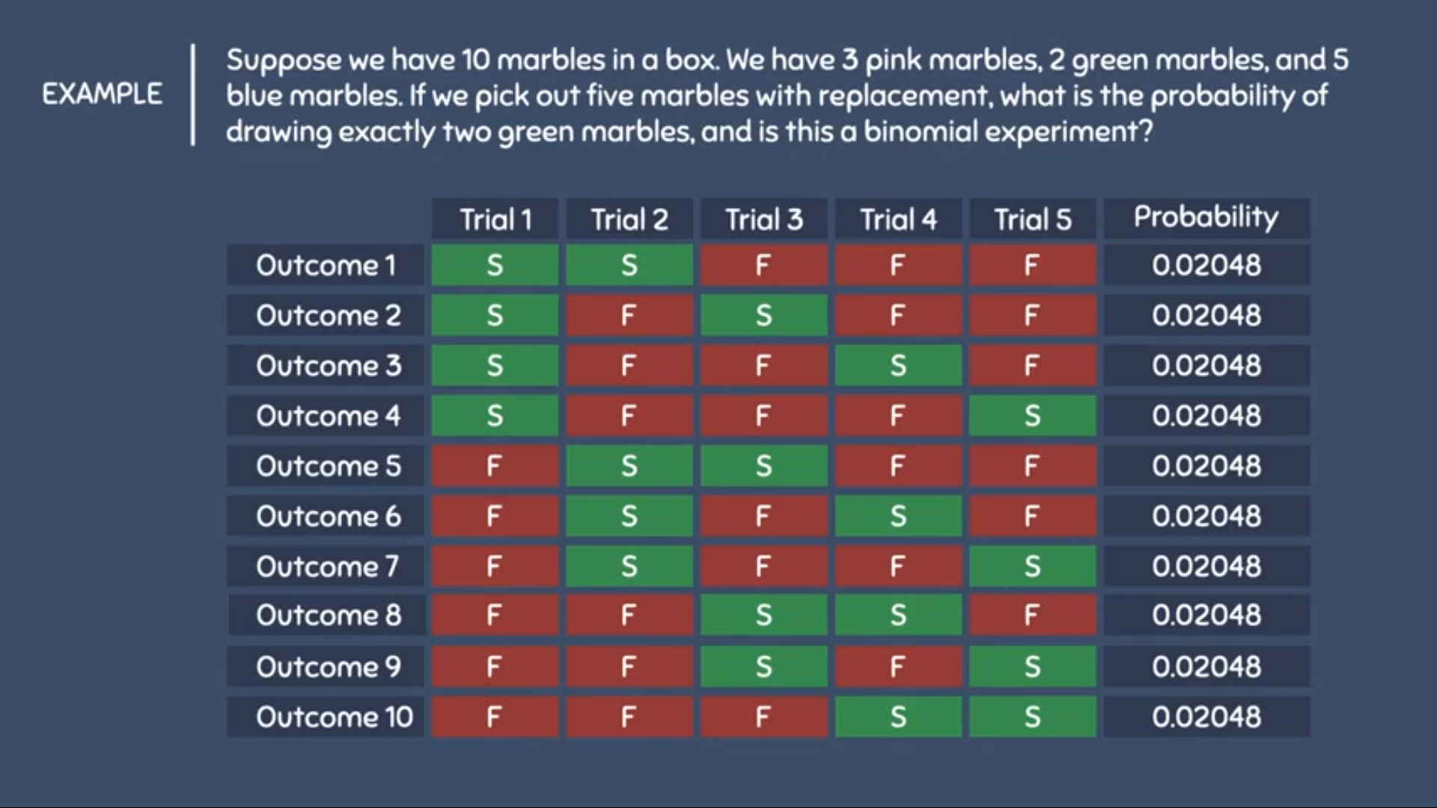
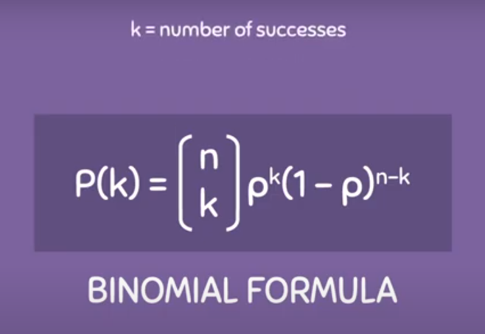
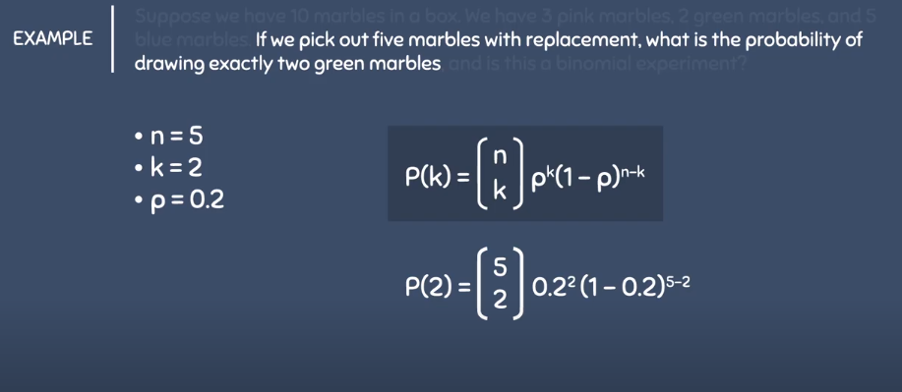
Binomial Distributions Contd…
OR

Slide 16
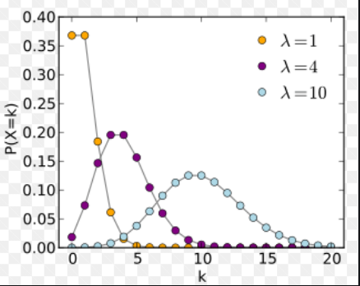
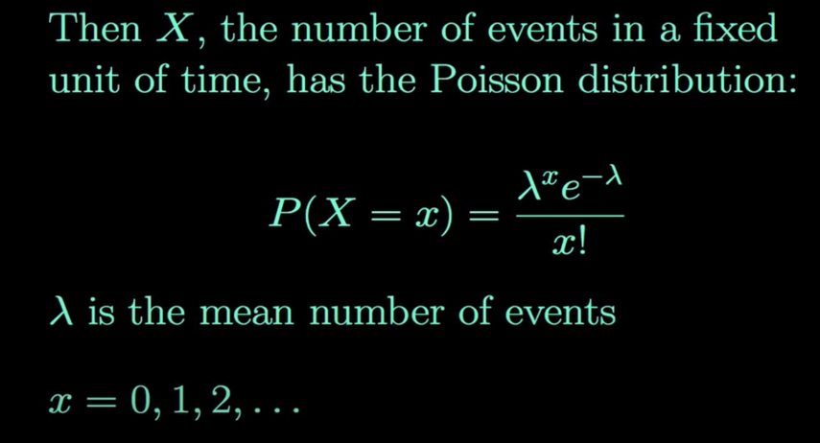
Discrete Distributions Contd…
Poisson Distribution – A Poisson random variable is a count of the number of occurrences of an event in a given unit of time, distance, area or a volume
Poisson Criteria -
Discrete outcomes
The number of occurrences in each interval can range from zero to infinity (theoretically)
Describes the distribution of infrequent (rare) events
Each event is independent of the other events
Describes discrete events over an interval
Expected number of occurrences E(X) are assumed to be constant throughout the experiment.
~Events are occurring randomly and independently
Note - Poisson distribution with lambda = np, closely appx. Binomial distribution if n is large and p is small
Parameters of Poisson Distribution -
Mean of Poisson Distribution – Lambda
Variance – Lambda
Examples – Let's say you are a cashier at Wal-Mart. It is 4:30pm and your shift ends at 5:00pm. The store policy is to close your checkout line 15 minutes before your shift ends (in this case 4:45) so that you van finish checking-out the customers already in your line and leave on-time.
By examining overhead cameras, store data indicates that between 4:30pm and 4:45pm each weekday, an average of 10 customers enter any given checkout line.
What is the probability that exactly 7 customers enter your line between 4:30 and 4:45? What is the probability that more than 10 people arrive? (Which means you will probably be on shift later than 5:00pm)

Slide 17
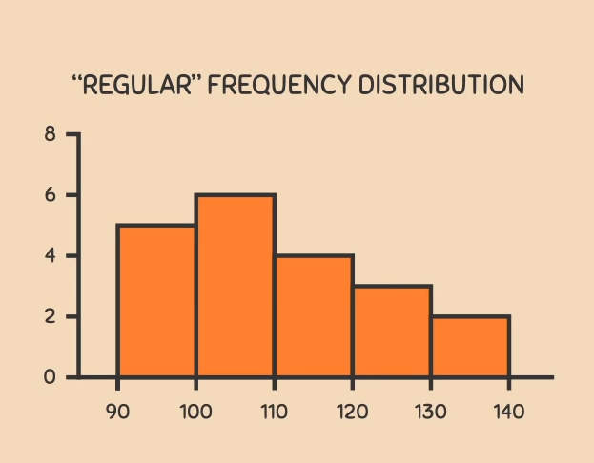
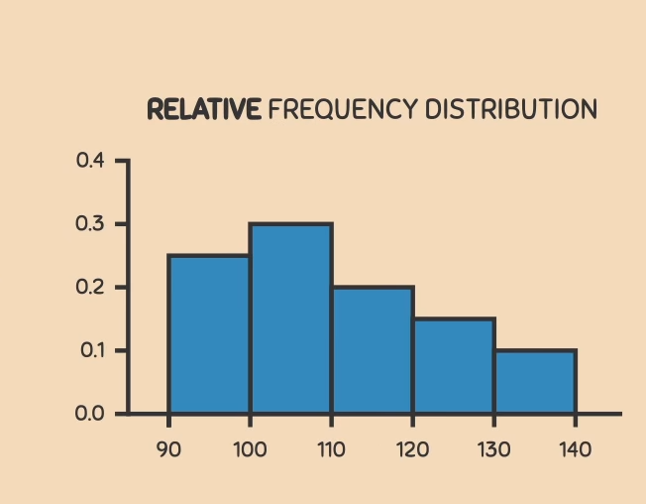
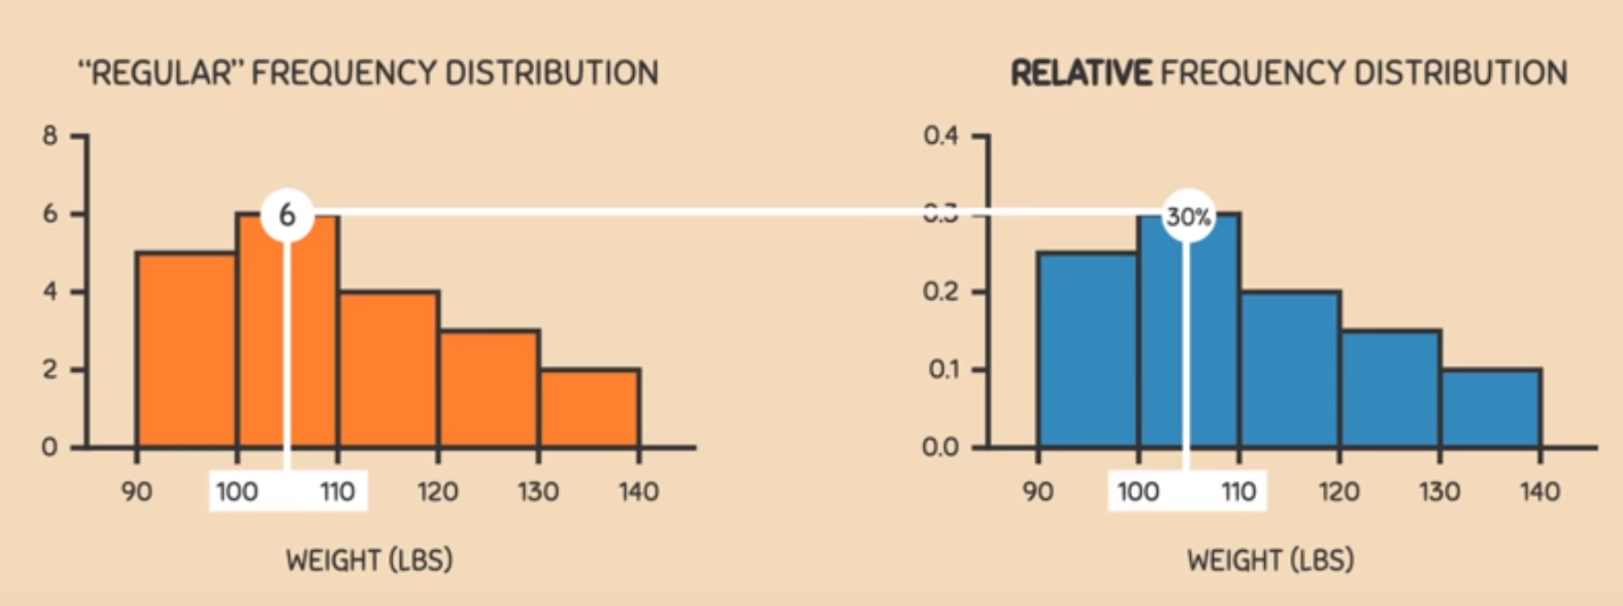
Density Curves – What are they & Where they are coming from?
Proportions of Individuals
N = 20
Weights in lbs

Slide 18
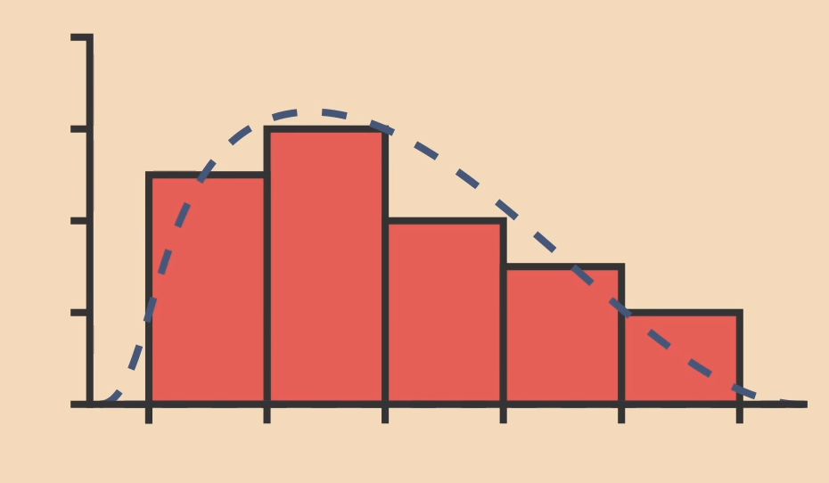
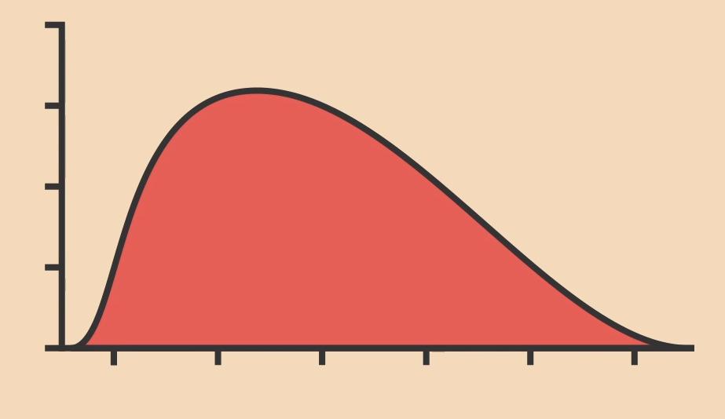
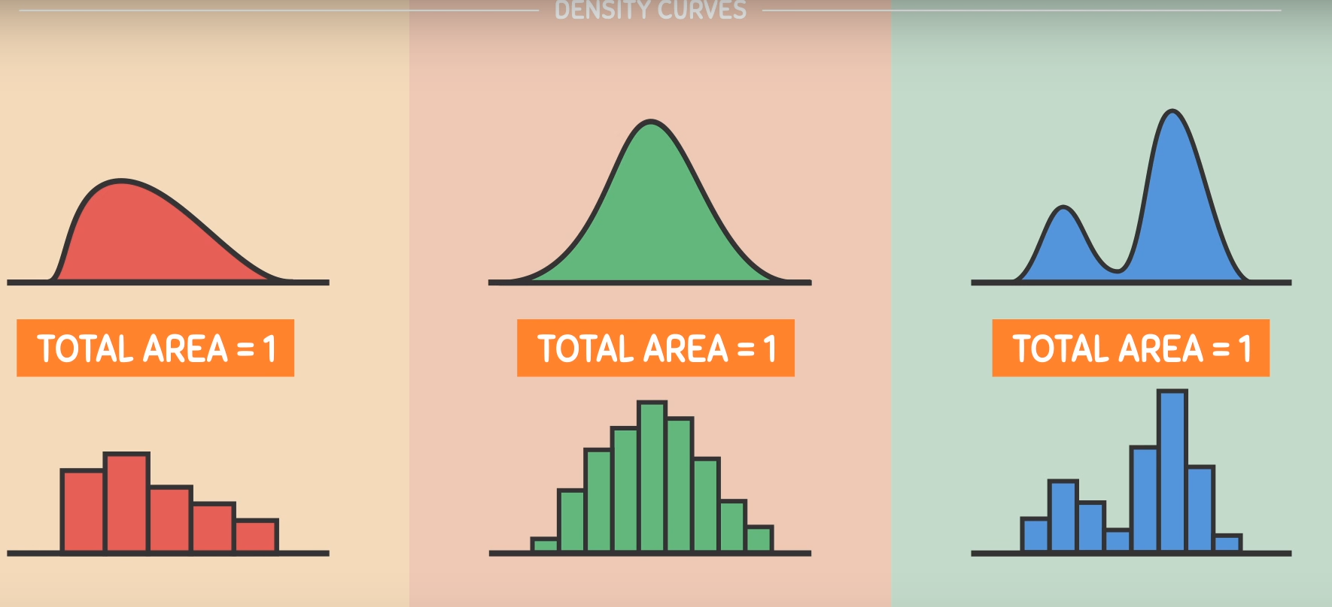
Where it is coming from – A Curve around the histogram itself…
Uses of Histograms
Histograms depends upon how we construct it and depends upon number of intervals we are considering
Density curves consider infinite amount of intervals – Independent
Uses of density curves – more popular

Slide 19
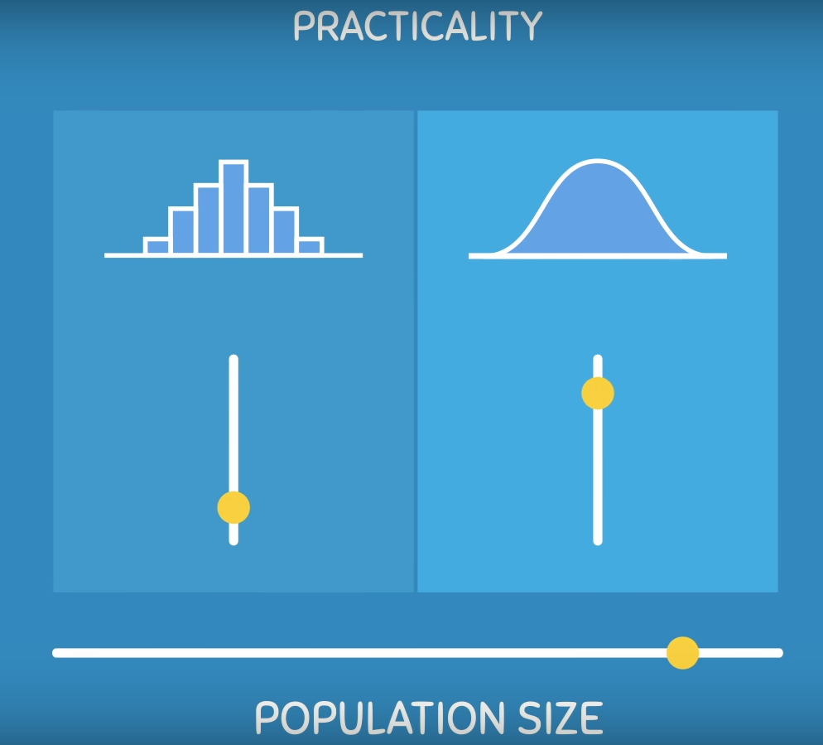
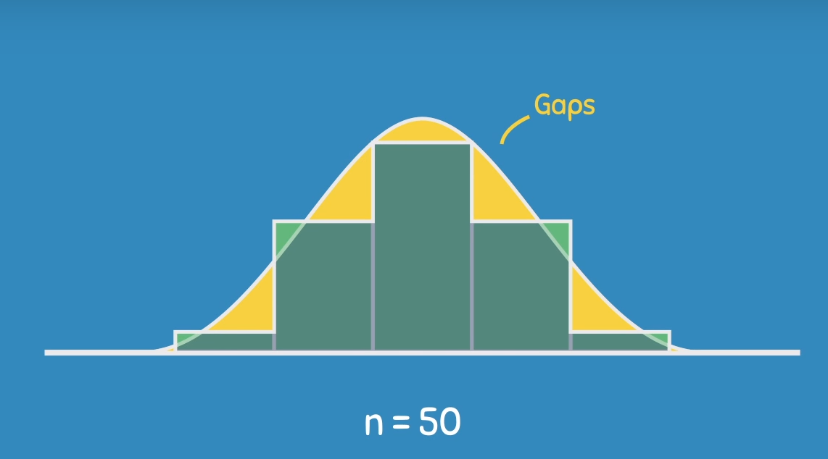
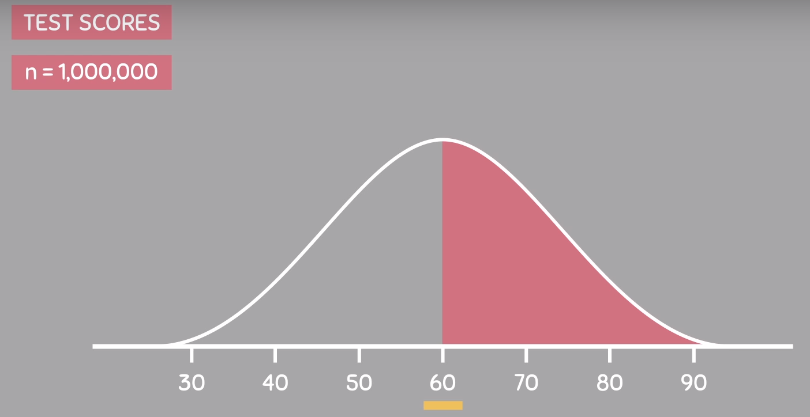
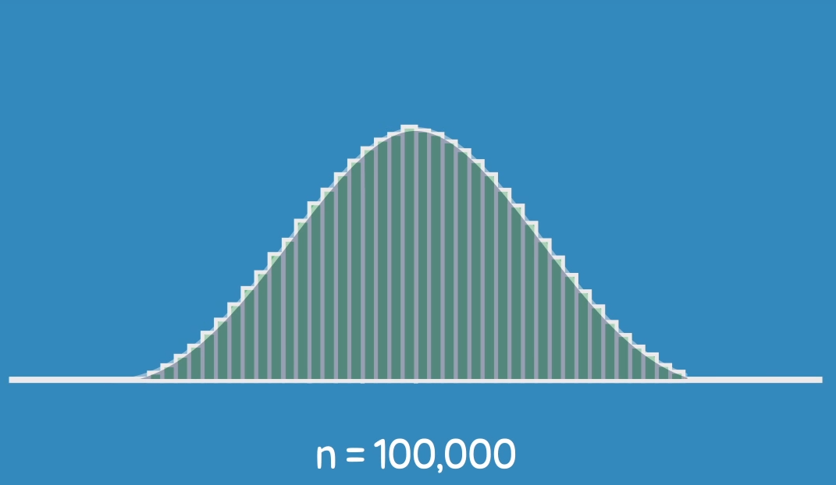
Uses of Density Curves – As Population/Sample size increases…
Might be inaccurate on small sample
Area of Interest

Slide 20
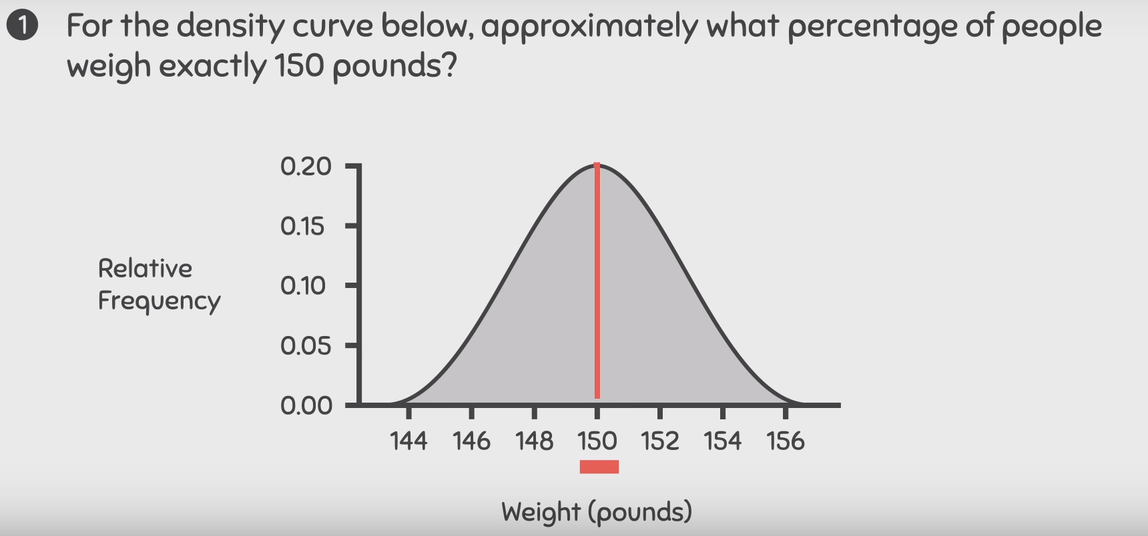
Practice Questions - 1

Slide 21
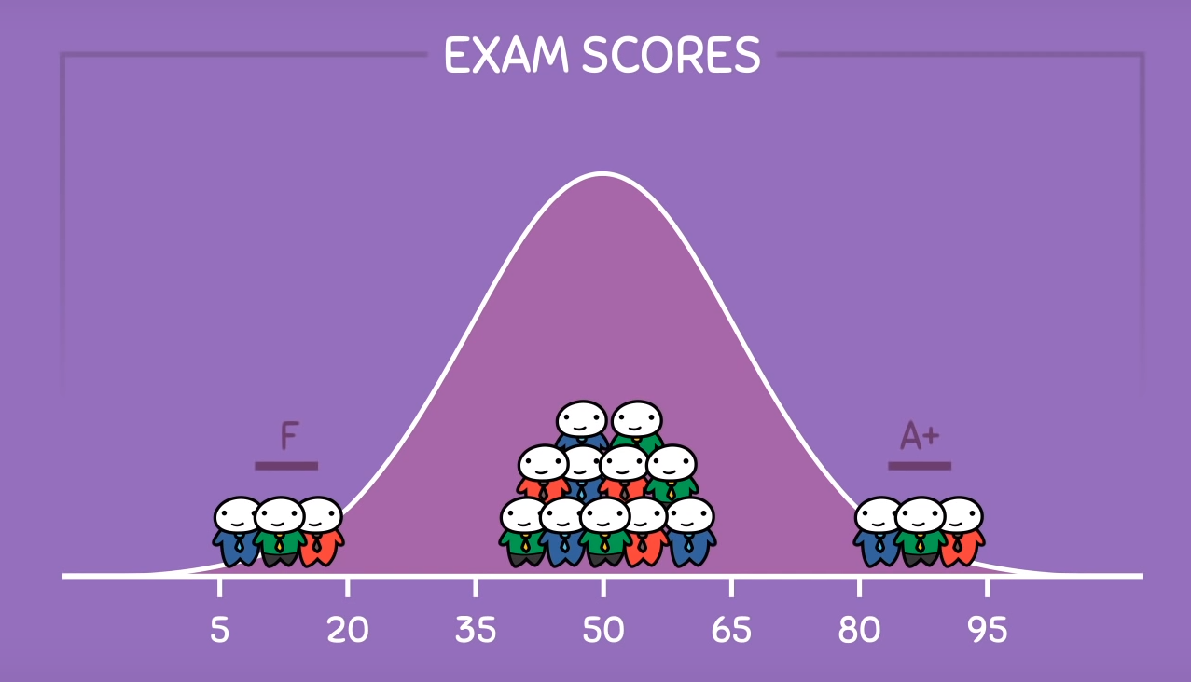
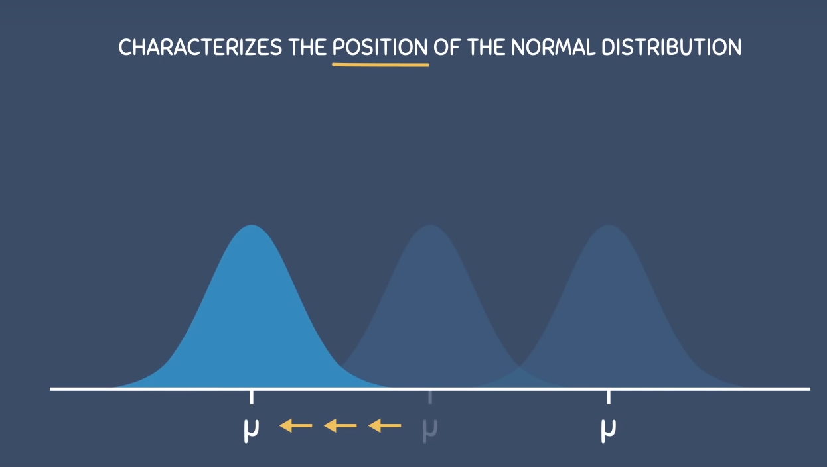
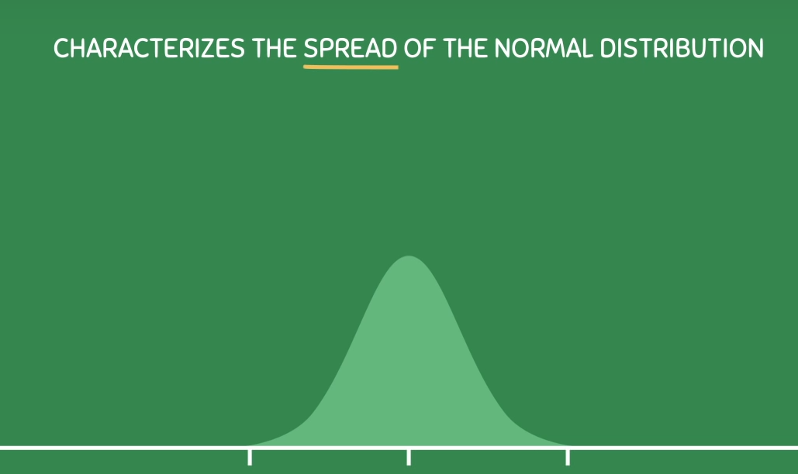
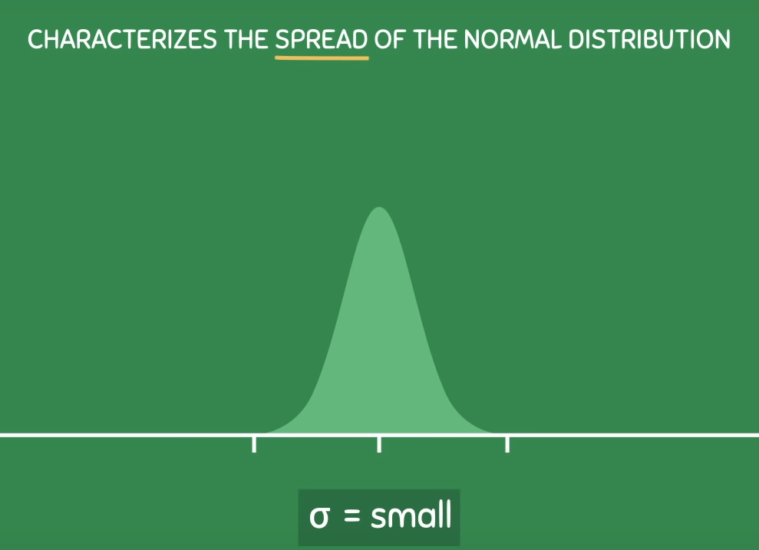
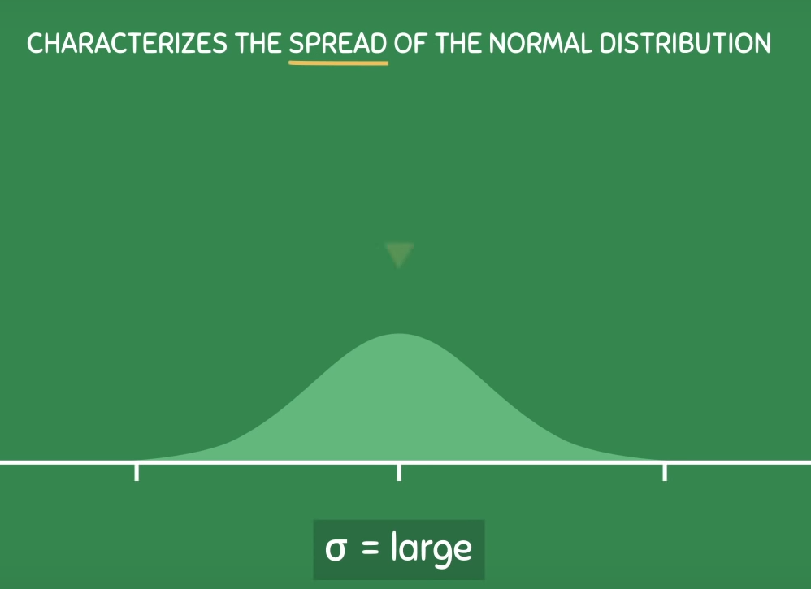
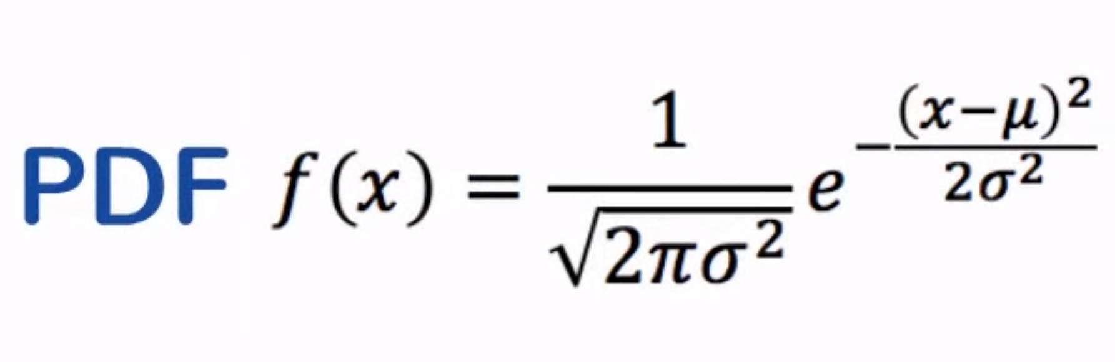
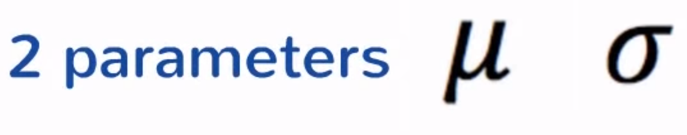
Normal Distribution – A special type of density curve
Mean – Position of bell curve
Standard deviation – Shape/Spread of bell curve

Slide 22
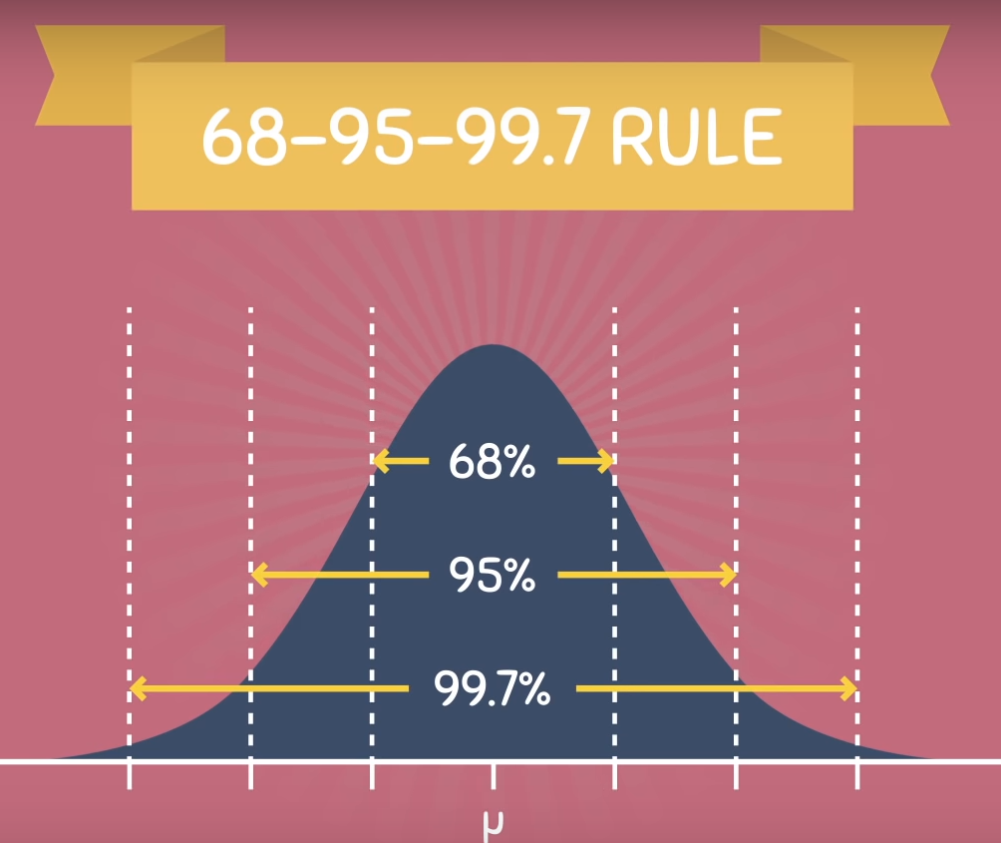
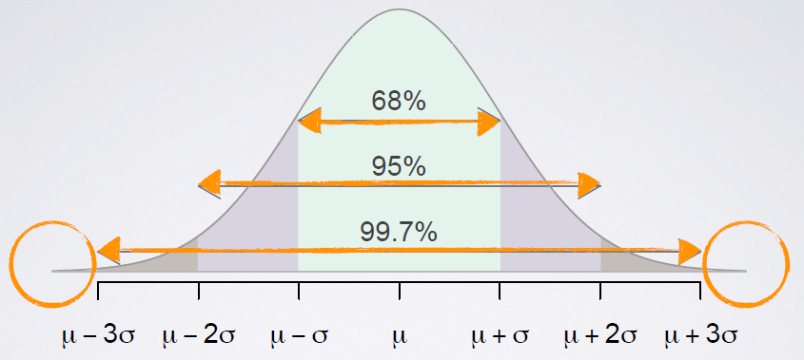

Normal Distribution – the 68-95-99.7 Rule

Slide 23
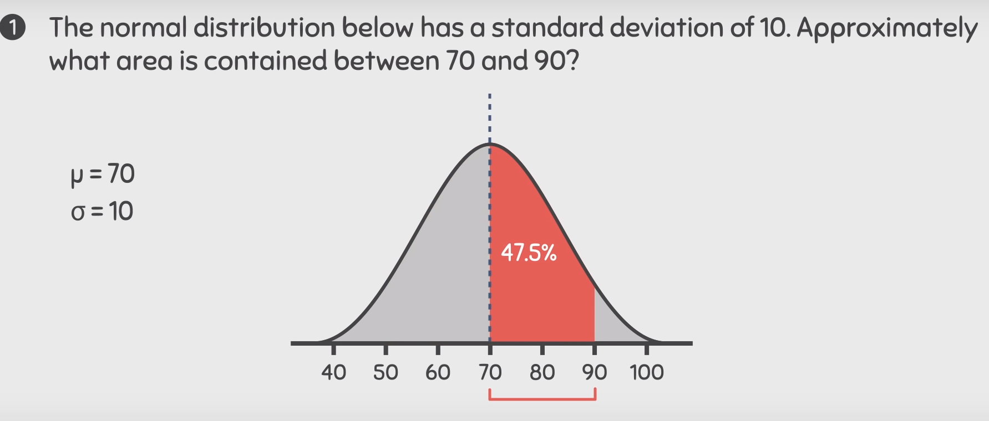
Practice Questions - 1

Slide 24
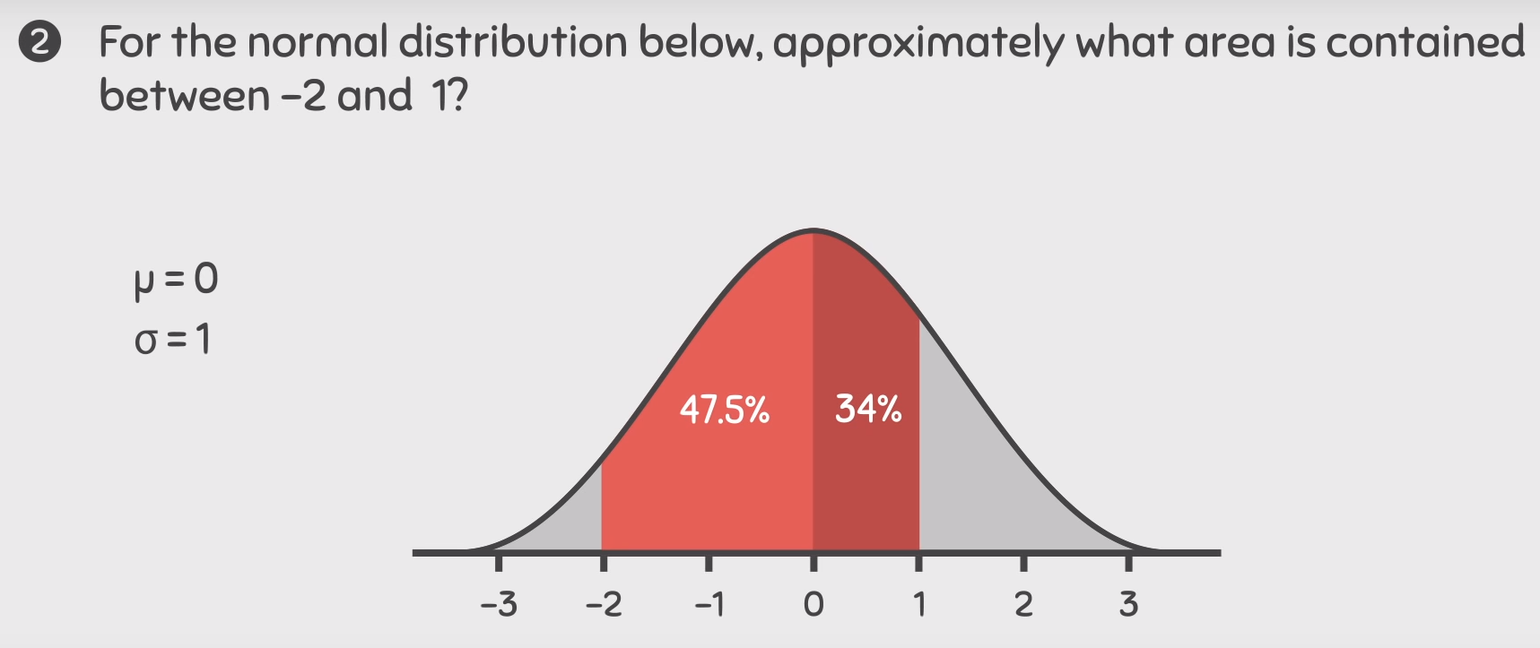
Practice Questions - 1

Slide 25
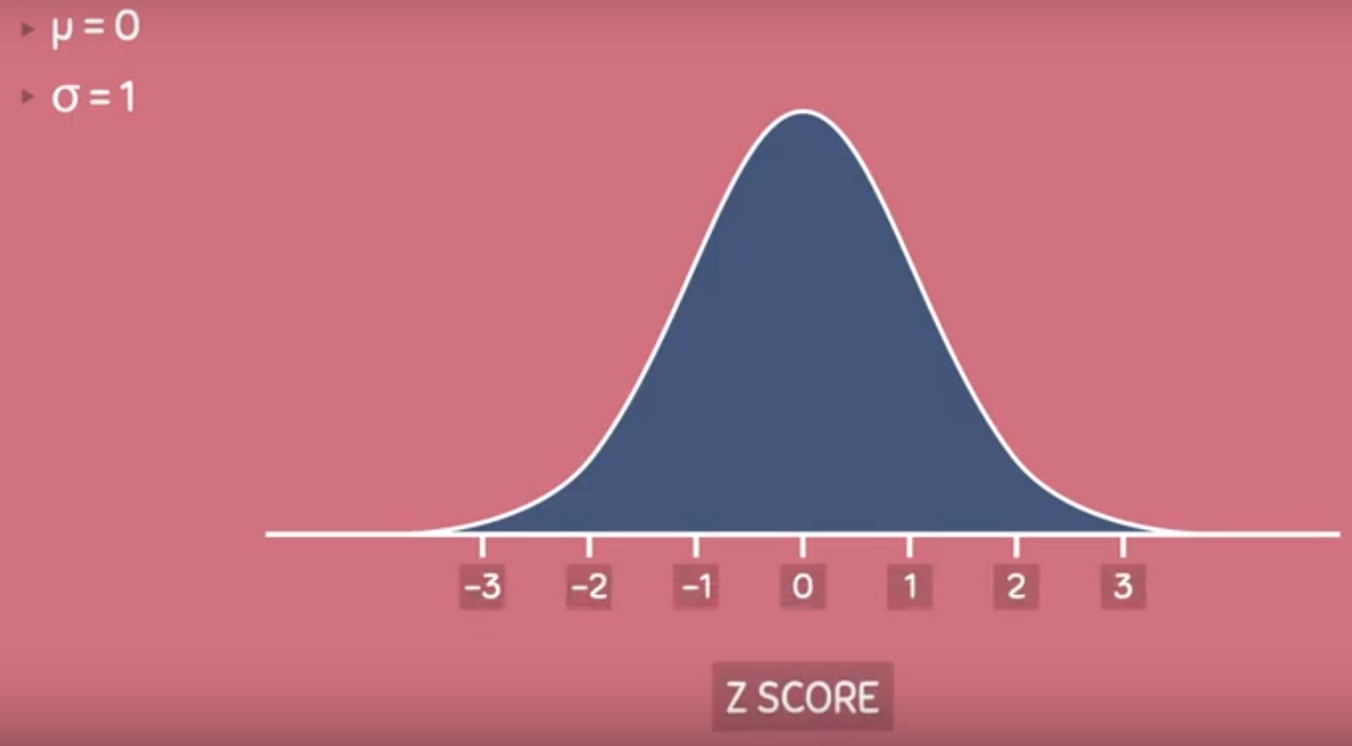
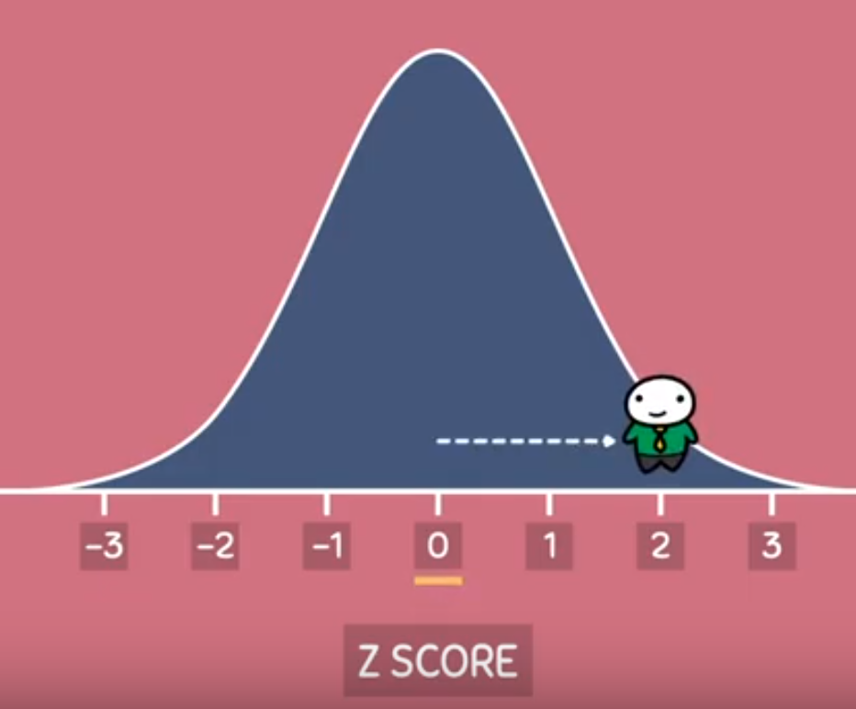
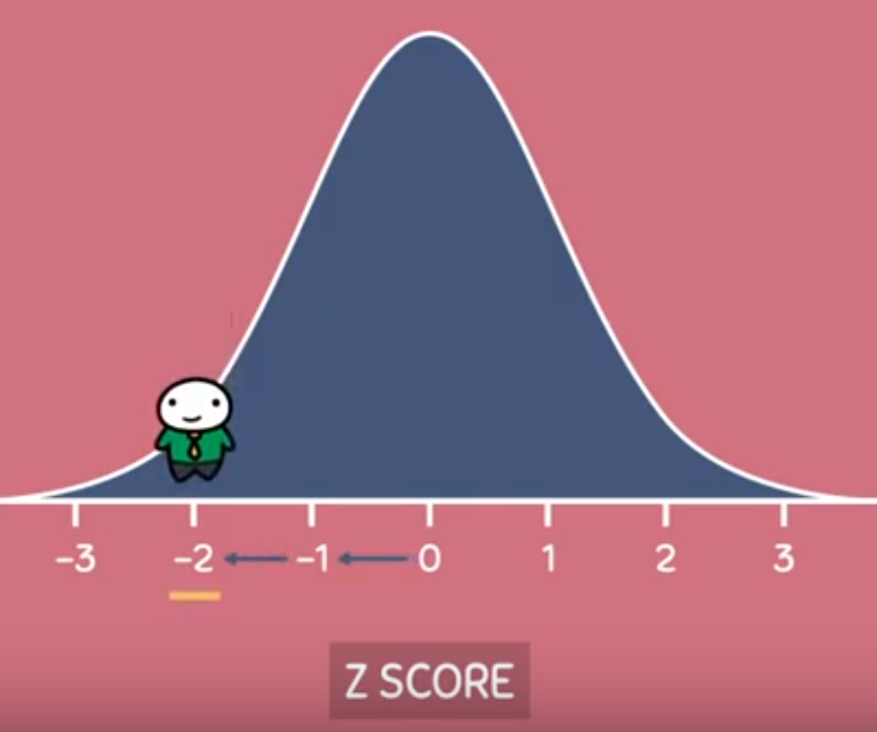
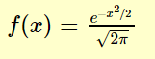
Standard Normal Distribution – A special type of Normal Distribution
2 s.d. right from mean
Mean – 0
Standard deviation - 1
2 s.d. left from mean

Slide 26
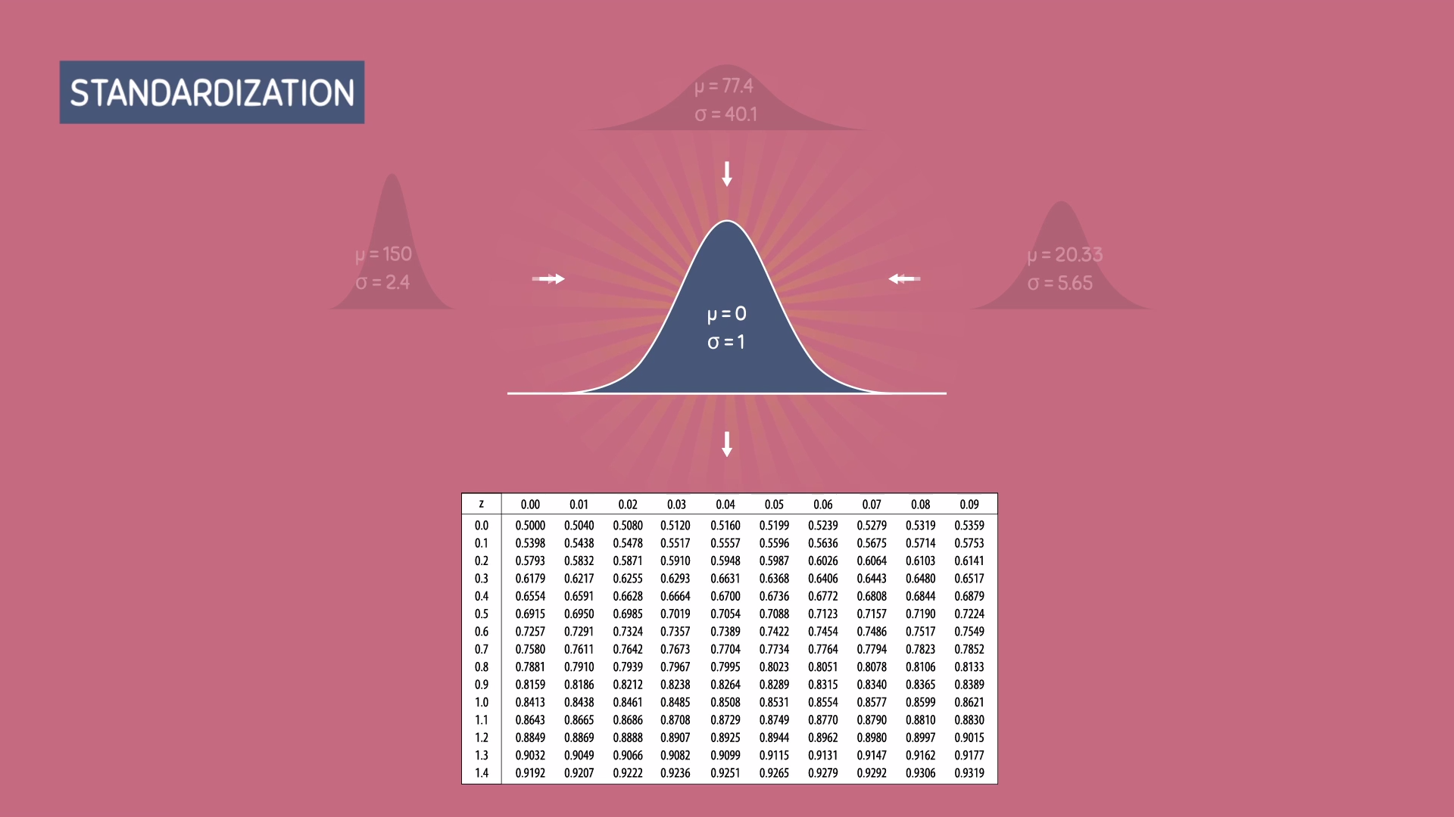
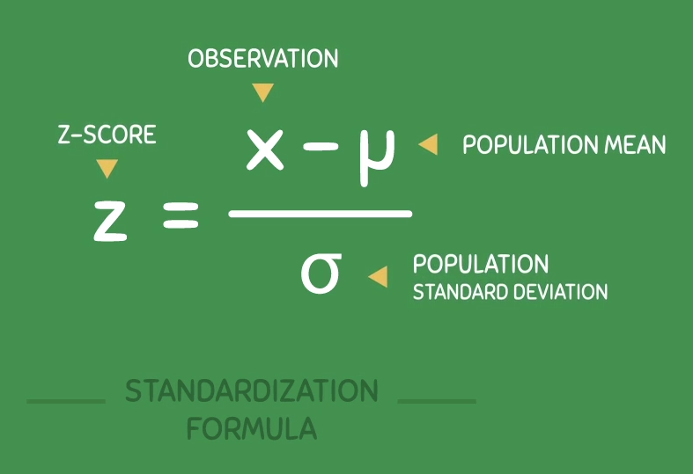
Standard Normal Distribution – How & Why do we calculate Z-Scores
Any Normal distribution can be converted into Standard normal distribution
Mean – 0
Standard deviation - 1

Slide 27
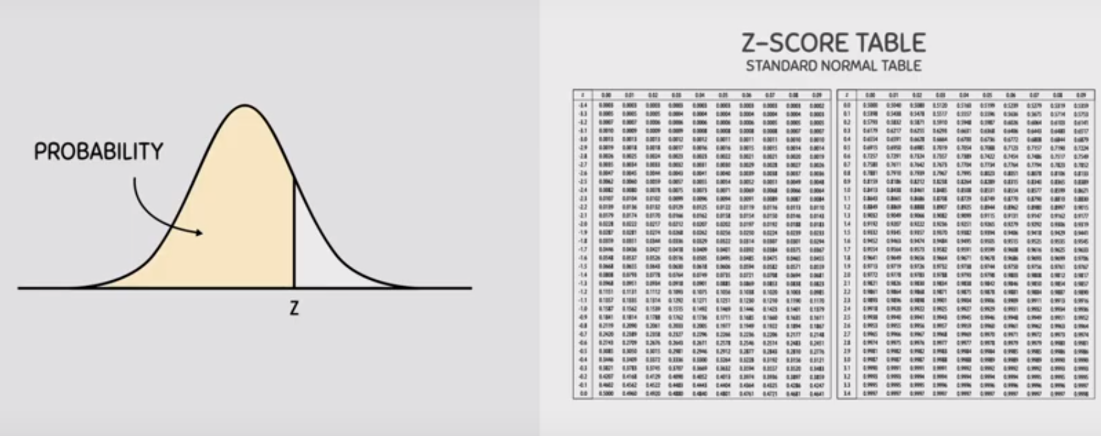


Standard Normal Distribution – Area of Z-scores
Mean – 0
Standard deviation - 1
Rows and Columns Z-Scores
Area (percentiles/percentage values inside the tables

Slide 28



Standard Normal Distribution – How do we calculate Z-Scores contd…
Any Normal distribution can be converted into Standard normal distribution
Mean – 0
Standard deviation - 1

Slide 29

Practice Questions - 1

Slide 30
Parameter v/s Statistics – Revisit..

Slide 31








Central Limit Theorem – Where it is applicable?

Slide 32













Central Limit Theorem – Where it is applicable?

Slide 33


Degrees of Freedom
Definition -
Degrees of freedom are the number of independent values that a statistical analysis can estimate.
The number of values that are free to vary as you estimate parameters.
Typically, the degrees of freedom equal your sample size minus the number of parameters you need to calculate during an analysis. It is usually a positive whole number.
T-Test:-
Chi-square Test:-
Notes:
https://statisticsbyjim.com/hypothesis-testing/degrees-freedom-statistics/

Slide 34

Chi-Square Test
The Chi-square test of independence determines whether there is a statistically significant relationship between categorical variables. It is a hypothesis test that answers the question—do the values of one categorical variable depend on the value of other categorical variables? This test is also known as the chi-square test of association. DF – (r-1)*(c-1)
Null hypothesis: There are no relationships between the categorical variables. If you know the value of one variable, it does not help you predict the value of another variable.
Alternative hypothesis: There are relationships between the categorical variables. Knowing the value of one variable does help you predict the value of another variable.

Slide 35



Chi-Square Test Contd…
Chi square distribution table with 1 degree of freedom and reading along the row we find our value of x²(3.418) lies between 2.706 and 3.841. The corresponding probability is between the 0.10 and 0.05 probability levels. That means that the p-value is above 0.05 (it is 0.065).
Since a p-value of 0.065 is greater than the conventionally accepted significance level of 0.05 (i.e. p > 0.05) we fail to reject the null hypothesis. In other words, there is no statistically significant difference in the proportion of animals whose heart rate increased.

